Slide 1

INJECTING RIGOR AND REPRODUCIBILITY INTO CITE-SEQ WORKFLOWS:
DECONTAMINATION AND IN SILICO GATING APPROACHES
Jamie Park/Ava Jensen, Tim Triche
Van Andel Institute Graduate School
Notes:
Hello everyone! My name is Jamie Park and I’m a grad student at the Van Andel Institute.
For this short talk, I would like to share some of our benchmakings of preprocessing packages for CITE-seq workflow.

Slide 2
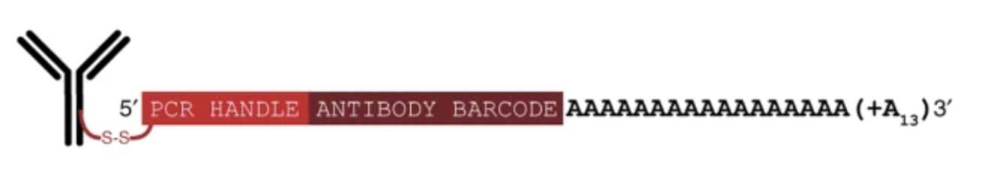
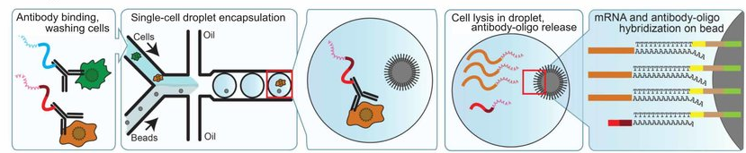
CITE-seq = scRNAseq + surface protein expression
Cellular Indexing of Transcriptomes and Epitopes.
ADT (antibody derived tags) allow co-sequencing of transcriptome + cell surface proteins.
Stoeckius, et al., 2017
Notes:
So what is CITE-seq?
CITE-seq is essentially single-cell RNA sequencing augmented with ADT, or antibody-derived tags. This innovation allows for simultaneous profiling of both the transcriptome and proteome at the single-cell level. CITE-seq was initially developed at the New York Genome Center in 2017, where it was first described in a paper published in Nature Biotechnology. The process involves incubating the cells with these oligonucleotide-labelled antibody cocktails, which act as unique barcodes for each protein of interest. Then, after microfluidics, cell lysis, reverse transcriptase, we can co-sequencing cell surface protein ADTs along with the single-cell transcriptome.
As of 2023, many variations of CITE-seq have been developed, each with its own unique advantages. However, the common advantage they share is the significant improvement they bring to the classification of cell types and states in complex tissues. This is especially valuable in scenarios where the transcriptome and proteome might provide discordant information
##
These oligonucleotides act as unique barcodes for each protein of interest. So following microfluidics, cell lysis and reverse transcription, the mRNA and the oligonucleotides attached to the antibodies are co-sequenced.
This way, CITE-seq can provides a comprehensive view of both the transcriptome and surface proteome of each single cell in a sample. This method can significantly improve the classification of cell types and states in complex tissues and in scenarios where the transcriptome and proteome might provide discordant information.

Slide 3
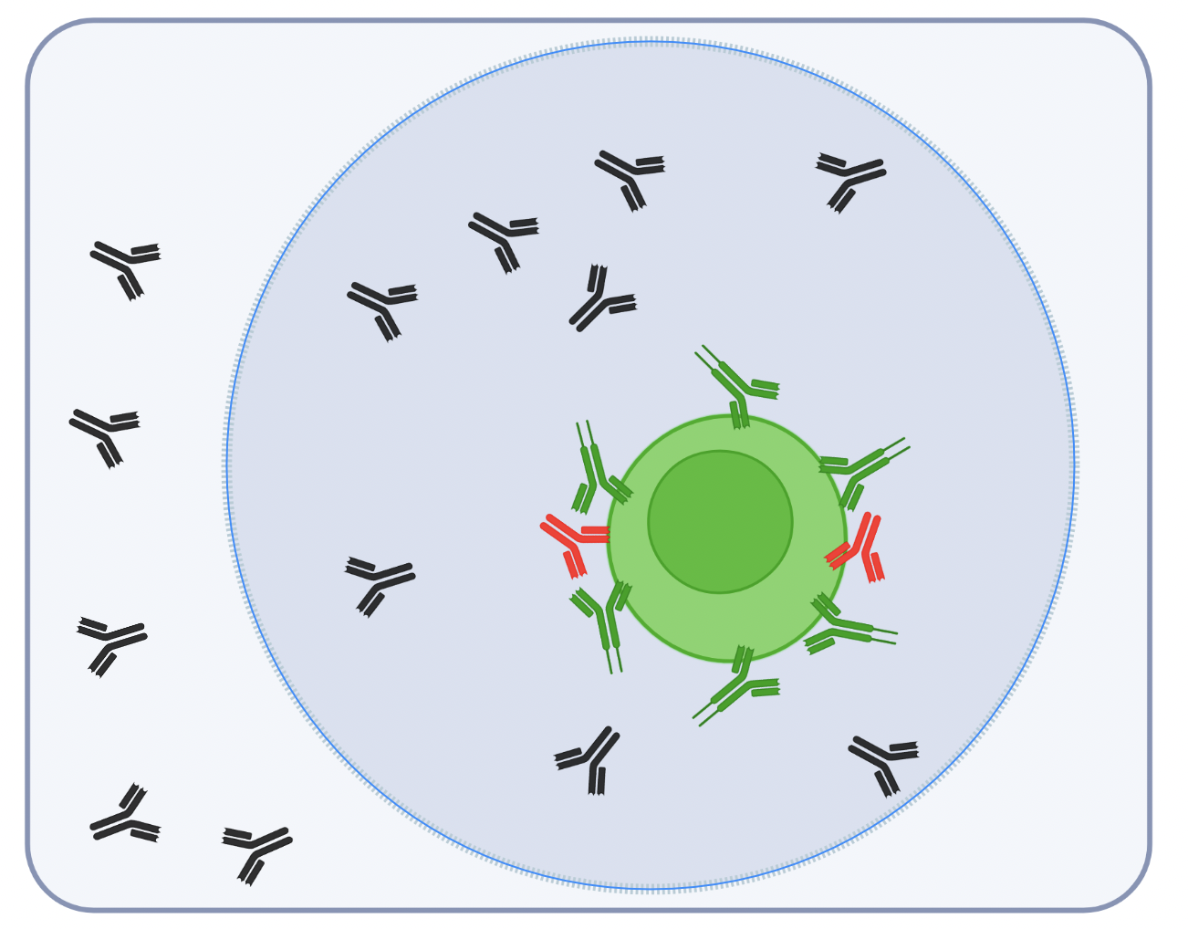
CITE-seq data is noisy.
Ambient Droplets
Non-specific Binding
Notes:
While CITE-seq can be an incredibly powerful tool for characterizing samples at the single-cell resolution, the preprocessing of CITE-seq data remains an active area of research. The strategies used for preprocessing can significantly influence cell type annotations, differential gene expression detection, and various other downstream analyses.
A primary focus of this ongoing research involves addressing the removal of background noise, in CITE-seq data.
Given that CITE-seq is an antibody-based technique, it can introduce a substantial amount of noise into the data.
To illustrate, consider a scenario where CD4 expression is plotted as a density plot in CITE-seq data.
The result is a trimodal distribution where the first peak does not necessarily represent real cells such as monocytes or T-cells.
Instead, this peak is reflects ambient antibodies that were encapsulated within the droplet during the experiment.
This highlights the need for effective strategies to identify and remove such background noise, thereby ensuring the reliability and validity of the results obtained from CITE-seq

Slide 4
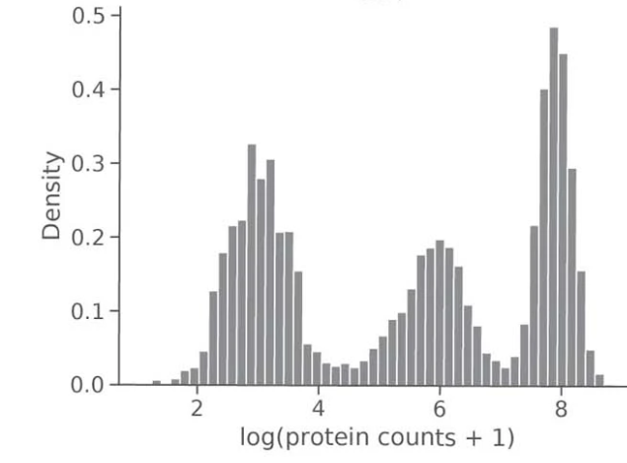
CITE-seq data is noisy.
CD4
Ambient Droplets
Non-specific Binding
Gayoso et al., 2021
Notes:
While CITE-seq can be an incredibly powerful tool for characterizing samples at the single-cell resolution, the preprocessing of CITE-seq data remains an active area of research. The strategies used for preprocessing can significantly influence cell type annotations, differential gene expression detection, and various other downstream analyses.
A primary focus of this ongoing research involves addressing the removal of background noise, in CITE-seq data.
Given that CITE-seq is an antibody-based technique, it can introduce a substantial amount of noise into the data.
To illustrate, consider a scenario where CD4 expression is plotted as a density plot in CITE-seq data.
The result is a trimodal distribution where the first peak does not necessarily represent real cells such as monocytes or T-cells.
Instead, this peak is reflects ambient antibodies that were encapsulated within the droplet during the experiment.
This highlights the need for effective strategies to identify and remove such background noise, thereby ensuring the reliability and validity of the results obtained from CITE-seq

Slide 5
CITE-seq data is noisy.
CD4
Ambient Droplets
CD4 expression of PBMC CITE-seq contain 3 modes (Background, Monocytes, and CD4+ T cells)
Non-specific Binding
Gayoso et al., 2021
Notes:
While CITE-seq can be an incredibly powerful tool for characterizing samples at the single-cell resolution, the preprocessing of CITE-seq data remains an active area of research. The strategies used for preprocessing can significantly influence cell type annotations, differential gene expression detection, and various other downstream analyses.
A primary focus of this ongoing research involves addressing the removal of background noise, in CITE-seq data.
Given that CITE-seq is an antibody-based technique, it can introduce a substantial amount of noise into the data.
To illustrate, consider a scenario where CD4 expression is plotted as a density plot in CITE-seq data.
The result is a trimodal distribution where the first peak does not necessarily represent real cells such as monocytes or T-cells.
Instead, this peak is reflects ambient antibodies that were encapsulated within the droplet during the experiment.
This highlights the need for effective strategies to identify and remove such background noise, thereby ensuring the reliability and validity of the results obtained from CITE-seq

Slide 6
Packages for decontamination in CITE-seq assays
pkg name | language | Pubs
dsb | R | Mulè, et al., 2022
decontX (celda) | R | Yang et al., 2020
totalVI (scVI) | python | Gayoso et al., 2021
scAR | python | Sheng et al., 2022 (bioRxiv)
Notes:
So over the past few years, multiple groups have developed computational packages that leverage statistical methods to estimate and eliminate these unwanted background signals, improving rigor and reproducibility in CITE-seq data analysis.
Several of these toolkits are publicly available and have been used within the scientific community. For the purposes of our discussion today, I'd like to focus on two specific methods, namely 'dsb' and 'decontX' two packages in R that We've benchmarked these tools as part of a CITE-seq preprocessing workflow, and I'm excited to share our findings with you.

Slide 7
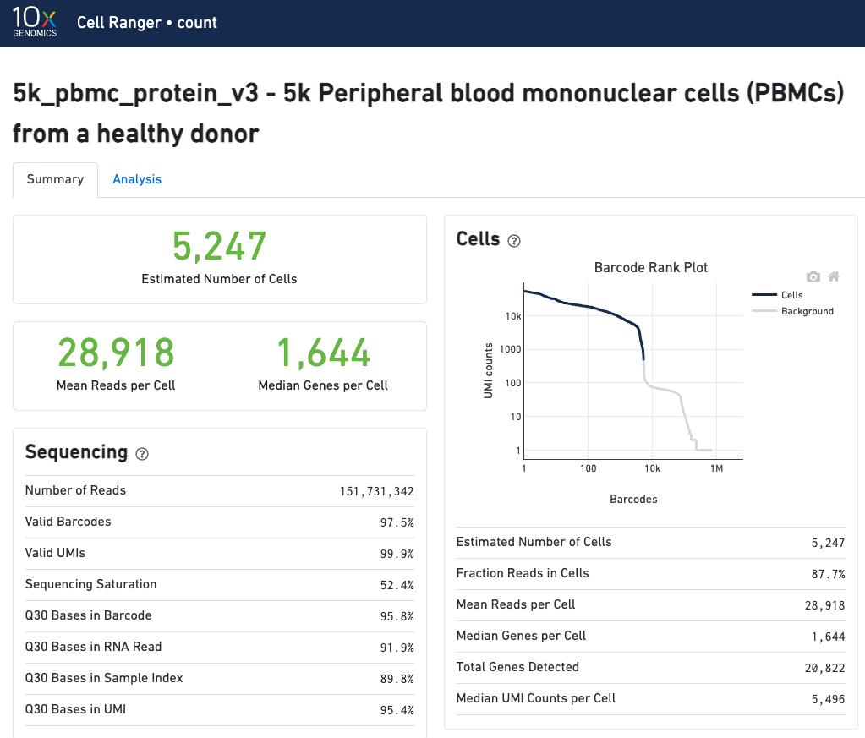
Using PBMC_5K on Macbook (M1) for reference
5k_pbmc_protein (v3) is a publicly available dataset from Genomics 10X
All packages were run locally on Macbook with 16Gb of RAM.
Notes:
As a reference dataset, I used the well-known PBMC dataset thats publicly available from Genomics 10X with ample documentation and QC metrics.
Additionally, I wanted to test the practicability of these packages from the perspective of a bench scientist, so I wanted it run on my beat up laptop.

Slide 8
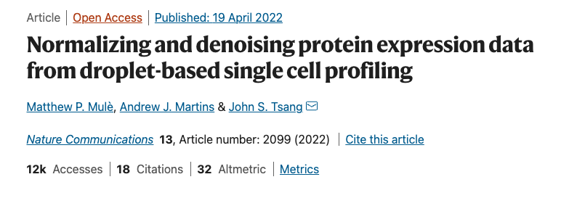

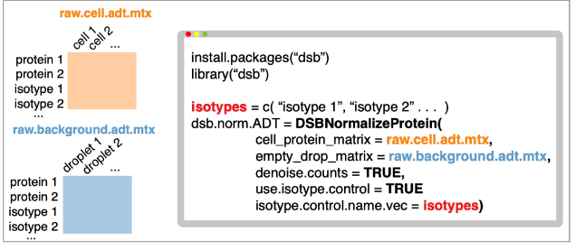
dsb uses empty droplet ADT expression to estimate noise.
2 types of noise :
Mule.et al, 2022
Notes:
The first package we tried was dsb, (denoised and scaled by background)
Dsb is a package released last year with publication at Nature comms and the authors identify two major components of noise in droplet-based single cell experiments:
First is the protein-specific noise originating from ambient, unbound antibody encapsulated in droplets.
Dsb can correct this protein-specific noise by taking into account of protein counts found in empty droplets matrices that are normally discarded. Essentially, the counts of each protein in cell-containing droplets are transformed by subtracting the mean and dividing by the std. deviation of that same protein across empty droplets.
Secondly, dsb is able to reveal celltype-specific noise by identifying the shared variance component associated with isotype antibody controls and background protein counts in each cell. In the PBMC 5K dataeset there are 3 IgG isotype controls, that we can feed it to.
The dsb function also automates scaleing and normalizes the dataset as well. It was very well documented and easy to install, so if one has access to the emptydroplets, meaning the raw filtered dataset and had used isotype controls in the antibody cocktail, dsb seems to be a very useful tool.

Slide 9
dsb uses empty droplet ADT expression to estimate noise.
2 types of noise :
Protein-specific noise from ambient antibodies
Can be estimated from “emptydrop” raw matrices.
Mule.et al, 2022
Notes:
The first package we tried was dsb, (denoised and scaled by background)
Dsb is a package released last year with publication at Nature comms and the authors identify two major components of noise in droplet-based single cell experiments:
First is the protein-specific noise originating from ambient, unbound antibody encapsulated in droplets.
Dsb can correct this protein-specific noise by taking into account of protein counts found in empty droplets matrices that are normally discarded. Essentially, the counts of each protein in cell-containing droplets are transformed by subtracting the mean and dividing by the std. deviation of that same protein across empty droplets.
Secondly, dsb is able to reveal celltype-specific noise by identifying the shared variance component associated with isotype antibody controls and background protein counts in each cell. In the PBMC 5K dataeset there are 3 IgG isotype controls, that we can feed it to.
The dsb function also automates scaleing and normalizes the dataset as well. It was very well documented and easy to install, so if one has access to the emptydroplets, meaning the raw filtered dataset and had used isotype controls in the antibody cocktail, dsb seems to be a very useful tool.

Slide 10
dsb uses empty droplet ADT expression to estimate noise.
2 types of noise :
Protein-specific noise from ambient antibodies
Can be estimated from “emptydrop” raw matrices.
droplet/cell-specific noise
Can be revealed by the shared variance component with isotype antibody controls
Mule.et al, 2022
Notes:
The first package we tried was dsb, (denoised and scaled by background)
Dsb is a package released last year with publication at Nature comms and the authors identify two major components of noise in droplet-based single cell experiments:
First is the protein-specific noise originating from ambient, unbound antibody encapsulated in droplets.
Dsb can correct this protein-specific noise by taking into account of protein counts found in empty droplets matrices that are normally discarded. Essentially, the counts of each protein in cell-containing droplets are transformed by subtracting the mean and dividing by the std. deviation of that same protein across empty droplets.
Secondly, dsb is able to reveal celltype-specific noise by identifying the shared variance component associated with isotype antibody controls and background protein counts in each cell. In the PBMC 5K dataeset there are 3 IgG isotype controls, that we can feed it to.
The dsb function also automates scaleing and normalizes the dataset as well. It was very well documented and easy to install, so if one has access to the emptydroplets, meaning the raw filtered dataset and had used isotype controls in the antibody cocktail, dsb seems to be a very useful tool.

Slide 11
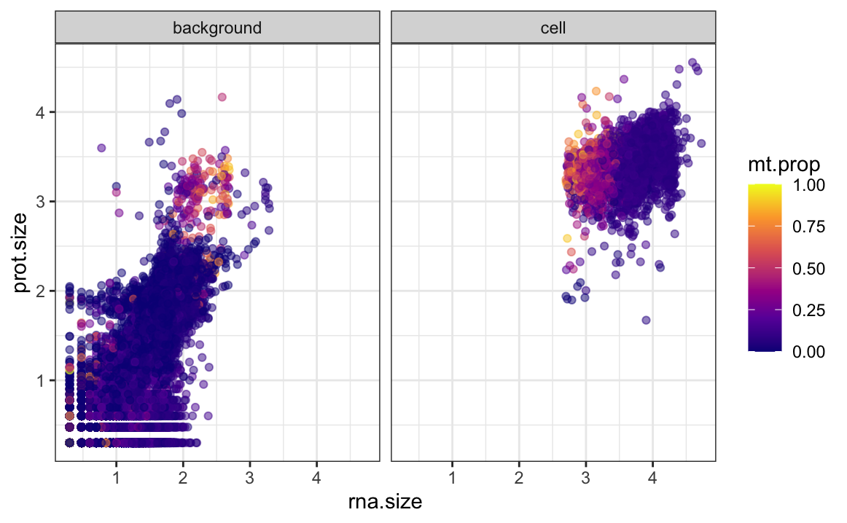
dsb decontaminated vs. raw ADT expression (CD4)
Notes:
The dsb workflow requires us to set the threshold of background vs. real cell based on detected protein size and rna size and here, I set the threshold for 2.5 for RNA, and anything thats lower than 1.5 and higher than 3 as empty.
Once we set the empty droplets, we can then run the dsb function. Its worth mentioning that the dsb function also automates scaling and normalizes the dataset as well. It was very well documented and easy to install, so if one has access to the emptydroplets, meaning the raw filtered dataset and had used isotype controls in the antibody cocktail, dsb can be a very useful tool.

Slide 12
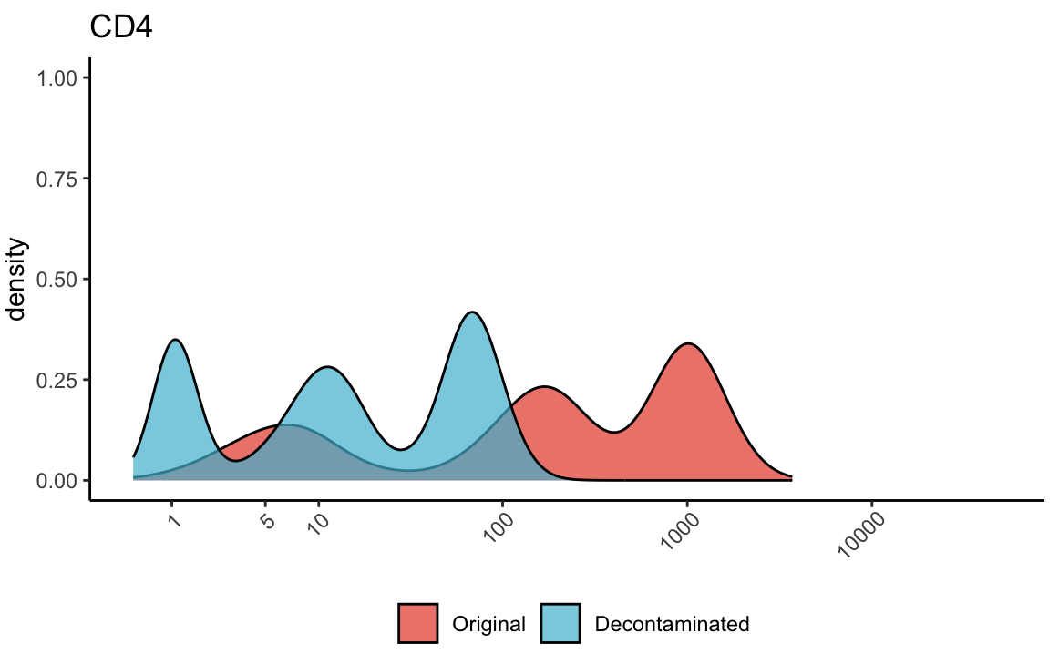
dsb decontaminated vs. raw ADT expression (CD4)
Output matrix was exponentiated for density plot comparison.
Notes:
The dsb workflow requires us to set the threshold of background vs. real cell based on detected protein size and rna size and here, I set the threshold for 2.5 for RNA, and anything thats lower than 1.5 and higher than 3 as empty.
Once we set the empty droplets, we can then run the dsb function. Its worth mentioning that the dsb function also automates scaling and normalizes the dataset as well. It was very well documented and easy to install, so if one has access to the emptydroplets, meaning the raw filtered dataset and had used isotype controls in the antibody cocktail, dsb can be a very useful tool.
##
Then, I plot the density of CD4 in comparison with the original matrix as red, and the decontaminated in blue.
What we notice here is that we still observe is the trimodality, but the peaks are more distinct, making the thresholding more easier.

Slide 13
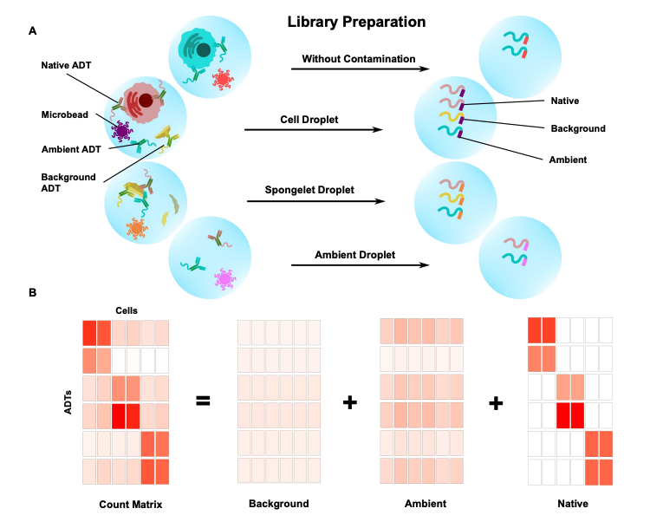
DecontPro also uses spongelets to remove contamination
Spongelet : cellular debris with antibody aggregates correlate with expression profiles of the background peak in true cells.
Bayesian hierarchical model to estimate/remove background.
Notes:
Another package we tried was decontX that has recently updated to decontPro.
DecontPro also recognizes the emptydroplets, but the authors identified a new type of artifact in the empty droplets called a “spongelet” which has medium levels of ADT expression but is distinct from ambient noise. The ADT expression levels in the spongelets correlate to ADT expression levels in the background peak of true cells in several datasets, suggesting that they can contribute to background noise along with ambient ADTs.
And by using a bayesian hierarchical model, decontPro estimates the posterior distribution estimates of the levels of contamination per cell.
In the context of DecontPro, it's likely that the Bayesian hierarchical model is used to estimate the levels of contamination in the antibody-derived tag (ADT) data. The model probably uses observed data (the ADT counts) and prior knowledge (perhaps about the expected levels of contamination or the properties of "clean" data) to estimate the posterior distribution of the contamination levels.

Slide 14
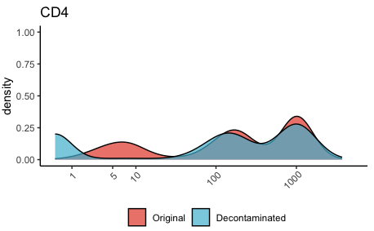
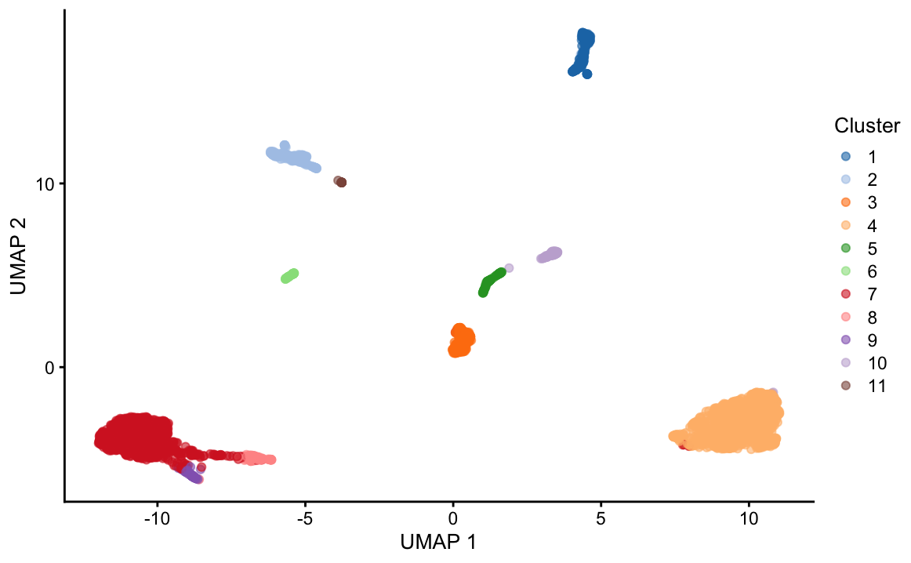
DecontPro decontaminated vs. raw ADT expression (CD4)
decontPro requires cluster info.
Notes:
For DecontPro, its worth mentioning that it requires cluster information to run its function. So we need to run the basic workflow of normalizing, finding variable features, PCA and clustering to run the decontamination. Here’ I’ve used the singlecellexperiment ecosystem packages but I’ve also checked the Seurat workflows are just as viable.
When I’ve plot the densityplot, the background peaks seems to have been parsed out, with little change in distribution of the true cells.
For 5000 cells, this took around 1.5hrs to complete the function and almost ran out of memory. So I can imagine decontPro may be difficult to scale.

Slide 15
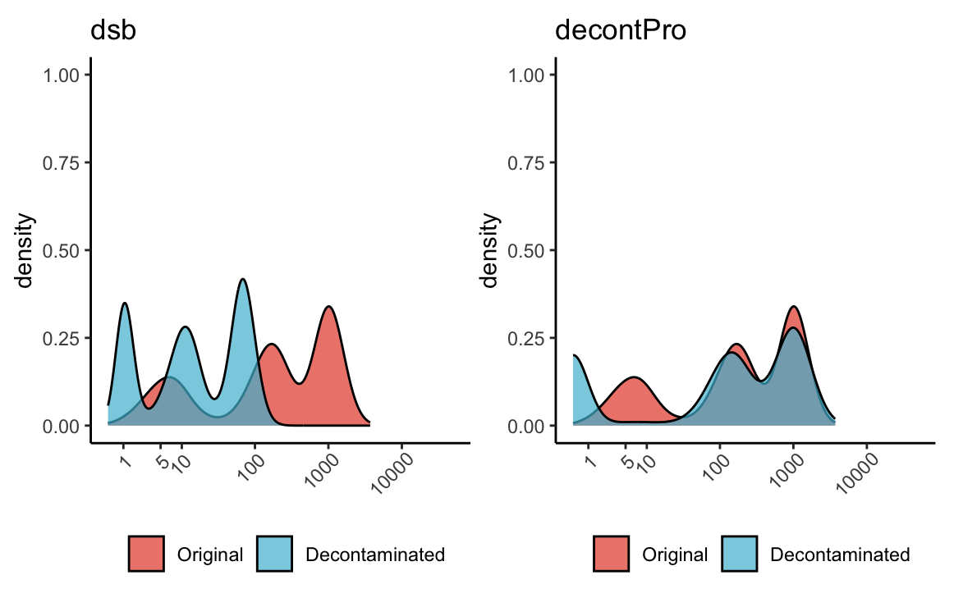
CD4 expression of dsb vs DecontPro decontamination
*dsb output is exponentiated for comparison
Notes:
Side by side dsb vs. decontPro looks like this.
Overall, dsb makes the backgrounds peaks more distinct, making the threshold setting more easier. decontPro on the other hand, while taking longer, can parse out the background peaks with the true cells relatively unchanged.

Slide 16
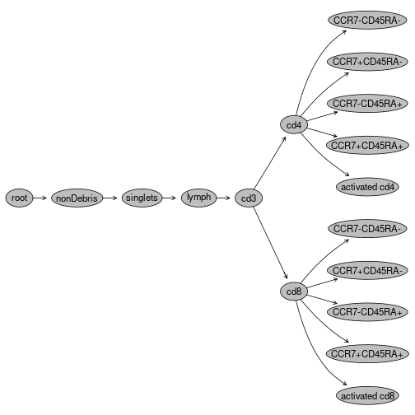
scGate can simulate flow cytometry gating
CytoML::flowjo_to_gatingset
Notes:
we also ventured cell-typing packages using CITEseq called scGate.
In flow cytometry, immunologists employ very sophisticated gating schemes to identify specific cell types.
Here’s a rather simple version of the gating set exported from FlowJo workspace.
scGate can simulate this gating method.
Normally, in sc analysis, the investigator would use classical markers to identify specific cell populations from heterogeneous sc datasets to identify and label clusters projected in UMAP. scGate is an algorithm that automates and simplifies this process by not requiring training data or reference gene expression profiles. What’s great for us was that it can also take in other modalities, including CITE-seq data.
(scGate is implemented as an R package and integrated with the Seurat framework, making it an intuitive tool to isolate cell populations of interest from heterogeneous single-cell datasets.)

Slide 17
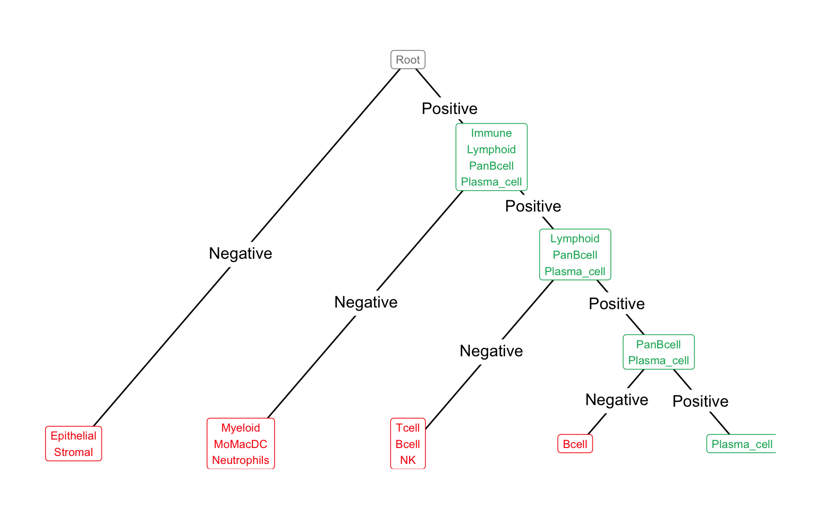
scGate can simulate flow cytometry gating
CytoML::flowjo_to_gatingset
scGate::plot_tree(my_scGate_model)
Notes:
we also ventured cell-typing packages using CITEseq called scGate.
In flow cytometry, immunologists employ very sophisticated gating schemes to identify specific cell types.
Here’s a rather simple version of the gating set exported from FlowJo workspace.
scGate can simulate this gating method.
Normally, in sc analysis, the investigator would use classical markers to identify specific cell populations and label clusters projected in UMAP. scGate is an algorithm that simplifies this process by not requiring training data or reference gene expression profiles. What was great for us was that it can also take in other modalities, including CITE-seq data.

Slide 18
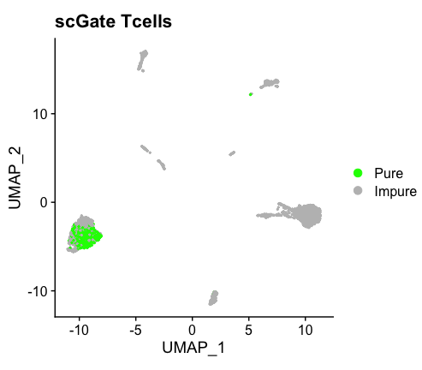
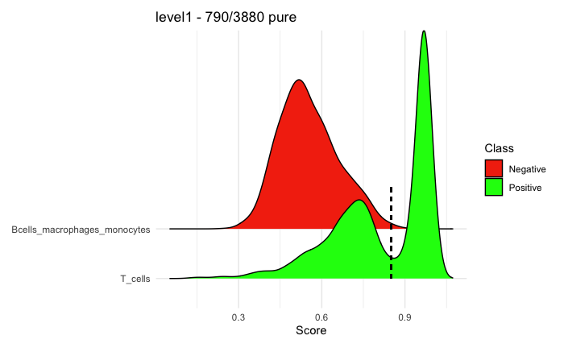
scGate can threshold gates to annotate pure T cells
*Ucell score* based thresholding
Notes:
So, using scGate, we manually created a gate with positive markers for T-cells and negative markers for B-cells and other myeloid cells.
While scGate currently has default gating schemes for PBMC data, its annotation is in genes. Also, most of the marker genes are not encoding the cellsurface markers used for CITE-seq, so for annotating based on cell-surface markers, we had to manually make our own gating schemes. Based on our gating we noticed that not all of the T-cells in the cluster could be labelled as ‘pure’.

Slide 19
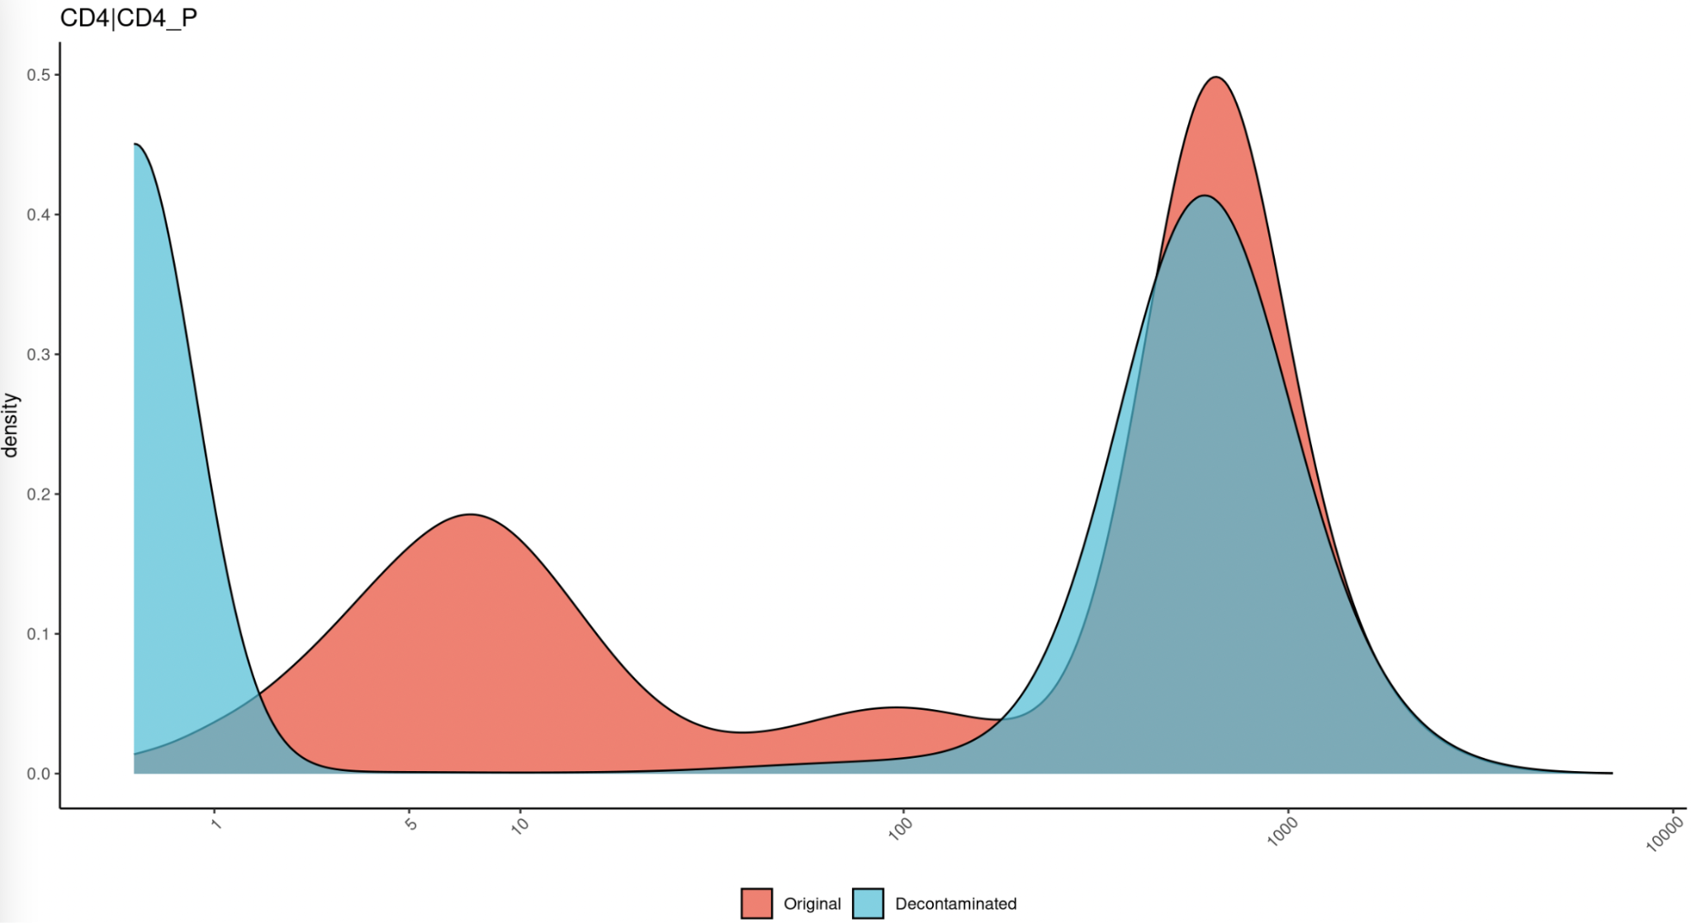
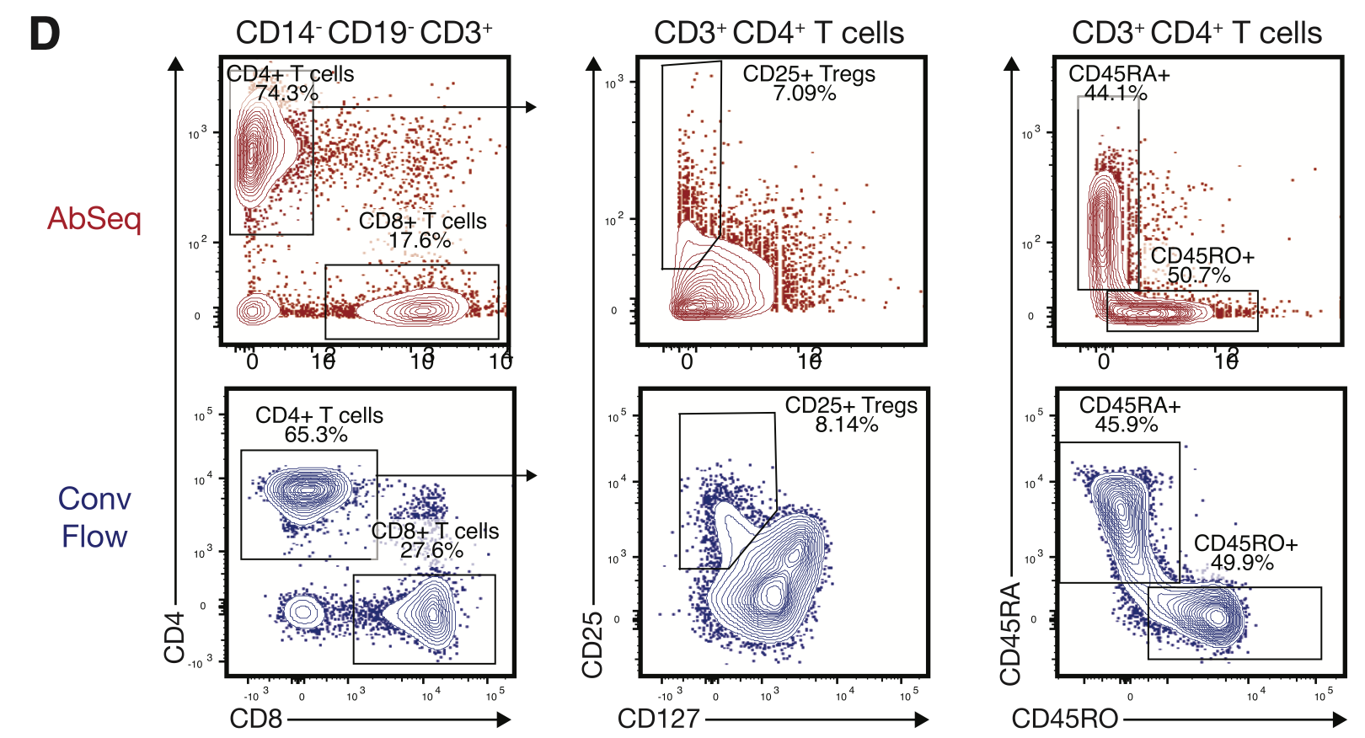
Mair et al., 2019 has run Abseq and flow in parallel
Nanowell-based (Rhapsody BD)
mRNA+ADT
28K cells
CD4
CD4
CD8
Notes:
Now that we had benchmarked these 3 packages, we sought to decontaminate *AND* annotate cell types, on a more real experiment.

Slide 20
Conclusions
 | decontPro (bioconductor) | Dsb (CRAN) | scGate (CRAN)
summary | Bayesian hierarchy Installation challenges Difficulty to scale without HPC | Uses emptydroplets Automates normalization Performs best with isotype controls | Automates marker-based purification with in silico gating sets
publication | Yang et al., (bioXriv) | (Mule et al., 2022, Nature Comms) | Andreatta et al., 2022, Bioinformatics)
Various packages can decontaminate ambient noise in CITE-seq matrices.
Dsb uses 1) empty droplets 2) isotype controls to estimate background
decontPro uses Bayesian hierarchical algorithms with cell cluster info to estimate contamination.
scGate can offer in silico gating strategies to annotate cells.

Slide 21



Acknowledgements
Tim Triche
Ava Jensen
Lauren Harmon
Zack Ramjan
References
Yang, S., Corbett, S.E., Koga, Y. et al. Decontamination of ambient RNA in single-cell RNA-seq with DecontX. Genome Biol 21, 57 (2020). https://doi.org/10.1186/s13059-020-1950-6
Gayoso, A., Steier, Z., Lopez, R. et al. Joint probabilistic modeling of single-cell multi-omic data with totalVI. Nat Methods 18, 272–282 (2021). https://doi.org/10.1038/s41592-020-01050-x
Massimo Andreatta and others, scGate: marker-based purification of cell types from heterogeneous single-cell RNA-seq datasets, Bioinformatics, Volume 38, Issue 9, March 2022, Pages 2642–2644, https://doi.org/10.1093/bioinformatics/btac141
Stoeckius, M., Hafemeister, C., Stephenson, W. et al. Simultaneous epitope and transcriptome measurement in single cells. Nat Methods 14, 865–868 (2017). https://doi.org/10.1038/nmeth.4380
Mair F, Erickson JR, Voillet V, Simoni Y, Bi T, Tyznik AJ, Martin J, Gottardo R, Newell EW, Prlic M. A Targeted Multi-omic Analysis Approach Measures Protein Expression and Low-Abundance Transcripts on the Single-Cell Level. Cell Rep. 2020 Apr 7;31(1):107499. doi: 10.1016/j.celrep.2020.03.063. PMID: 32268080; PMCID: PMC7224638.
Orcid

Slide 22
BACKUPSLIDES
Mostly on LASRY
Notes:
Biorender this please…
Mair et al., needs conclusion

Slide 23
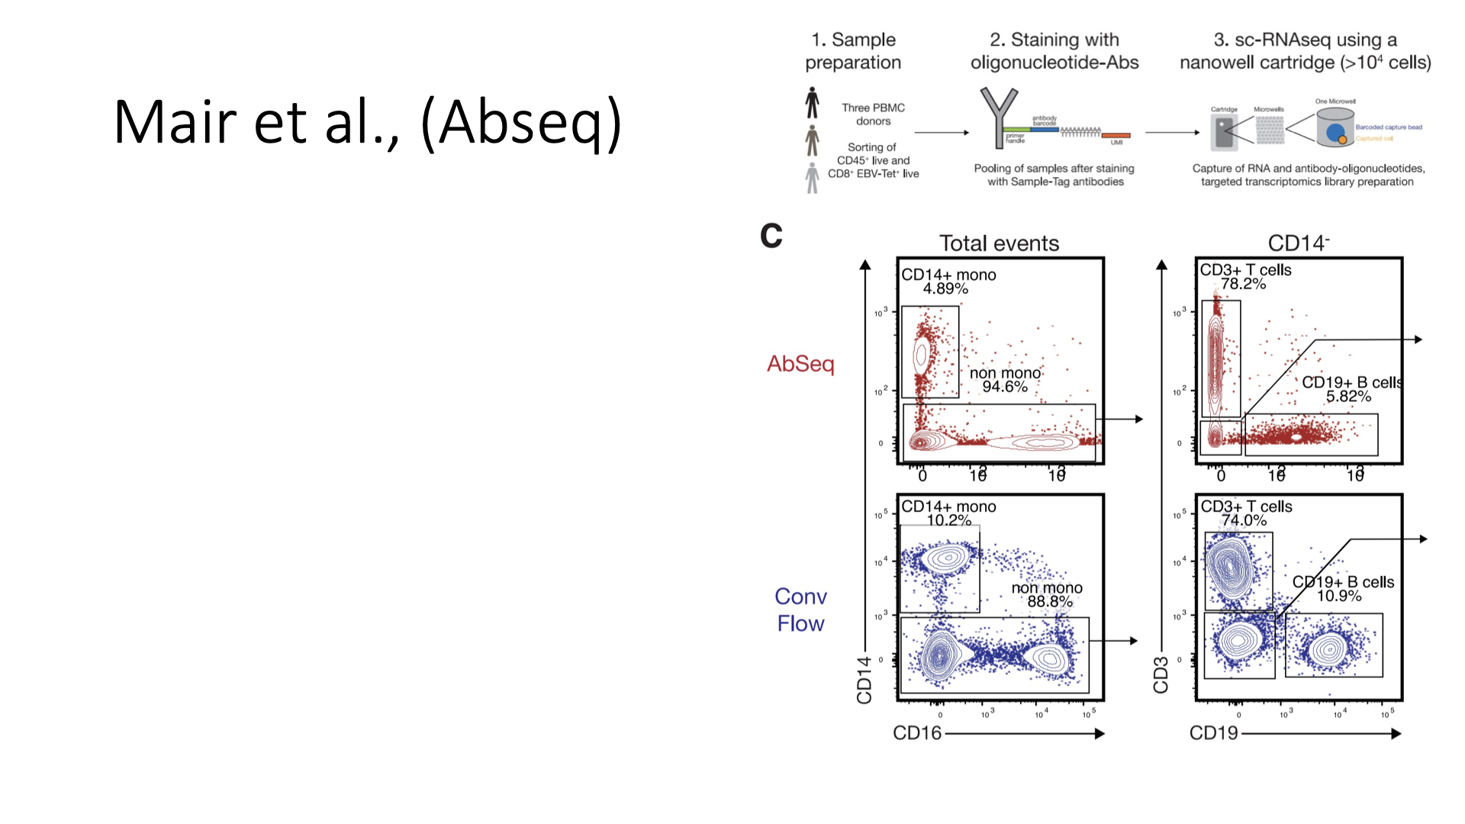
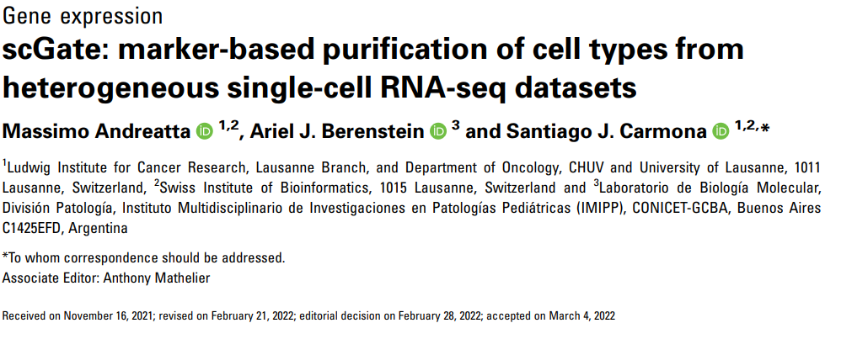

Slide 24
Single-cell transcriptomic and proteomic assays have added substantial breadth and depth to our understanding of cellular phenotypes and interactions. Particularly in the study of cellular immunity, the recent CITE-seq and REAP-seq protocols (which simultaneously assay hundreds of cell surface proteins alongside thousands of mRNA transcripts) have provided a robust and scalable means to dissect tissue- and condition-specific roles of individual cells.
However, the most appropriate means to preprocess these assays remains an open research topic with substantial implications for harmonized atlases of cell states and fates. Moreover, the majority of single-cell transcriptomic discoveries are evaluated against flow cytometric and functional characterization.
Here we present a comparative evaluation of in silico and flow cytometric gating approaches for analyzing CITE-seq data. We investigate the relative strengths of decontPro and dsb as decontamination tools, and employ the scGate package to simulate in silico gating to allow interpretation of the downstream consequences.
Importantly, when isotype controls and mRNA UMI counts are available, conclusions can be substantially affected by decisions to use or ignore these modalities in normalization, decontamination, and clustering.
DecontX (which implements DecontPro) is a Bioconductor package that identifies and removes potential cell doublets and contaminating cells from single-cell data.
DSB, hosted on CRAN is another package that normalizes and denoises antibody derived tag data from CITE-seq datasets, and pioneered the use of isotype controls for background normalization.
scGate (hosted on CRAN) employs the UCell Bioconductor package to enable a reproducible, semi-supervised, in silico gating approach akin to more traditional flow cytometric gating. In conjunction with contemporary preprocessing and clustering-based workflows for CITE-seq data, scGate allows us to compare the outcomes of in silico gating on properly preprocessed CITE-seq data against flow cytometric counts of cells prepared via enrichment protocols. This provides a lens to judge the relative merits of decontamination workflows. Finally, we apply our findings from the above benchmarking experiments to a primary dataset of human bone marrow samples from healthy donors and pediatric leukemia patients. The results hold implications for clinical translation of multimodal single-cell profiling of patients and extensions to patient care in high-risk applications with no standard of care.

Slide 25
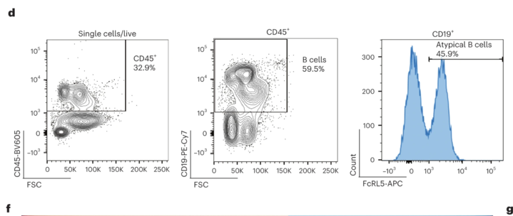
Flow results from flow sorting B cells in https://www.nature.com/articles/s43018-022-00480-0/figures/3
Notes:
Flow results from flow sorting B cells in

Slide 26
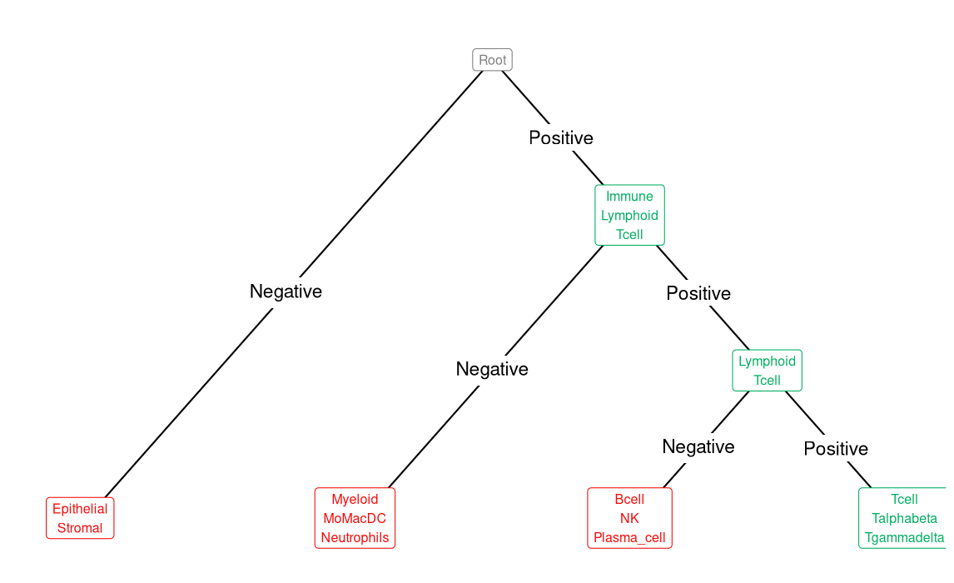
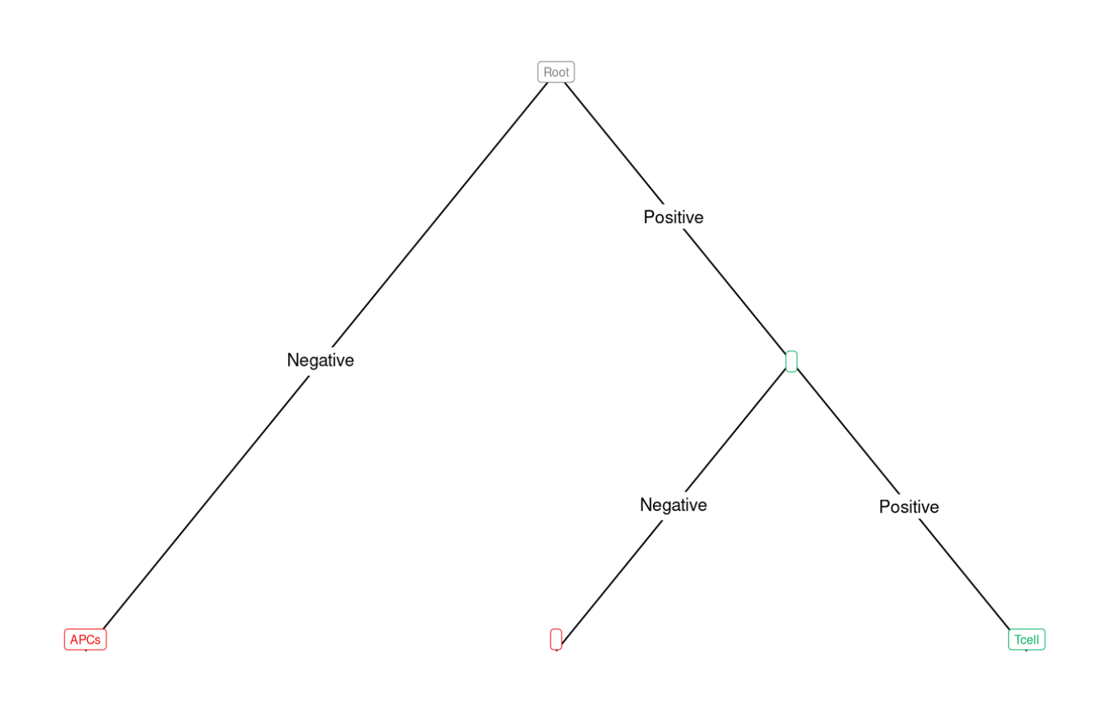

Slide 27
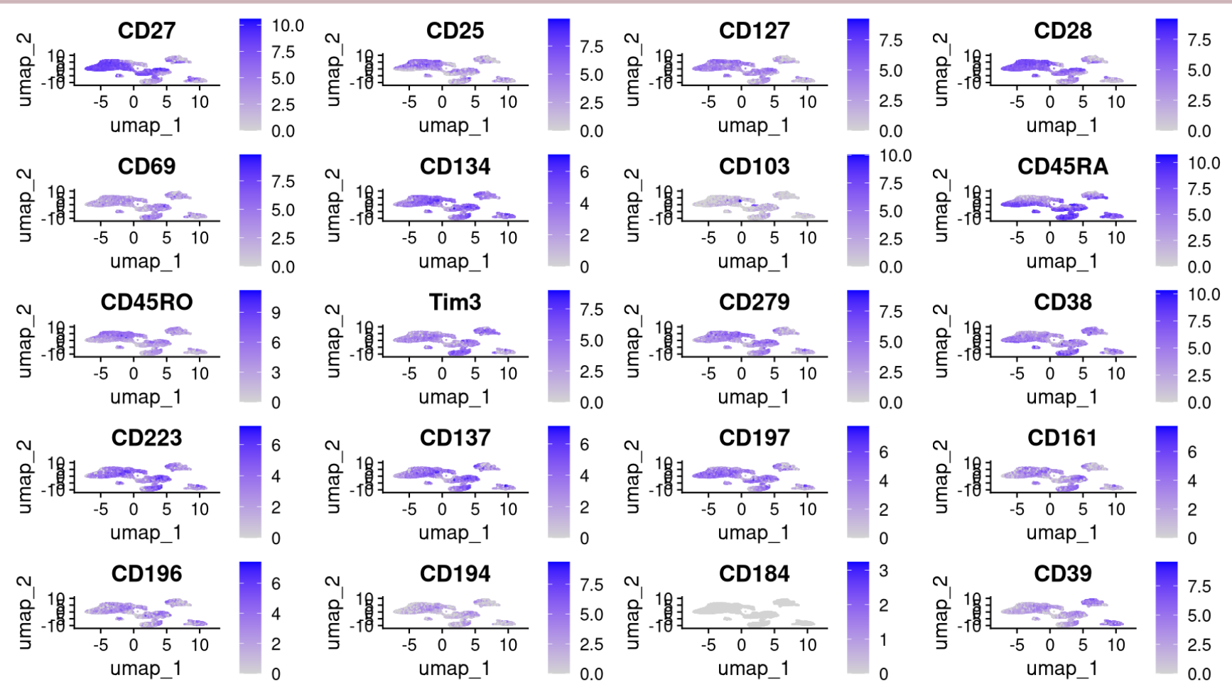
Expression of Positive Markers
Notes:
Lower the gate .

Slide 28
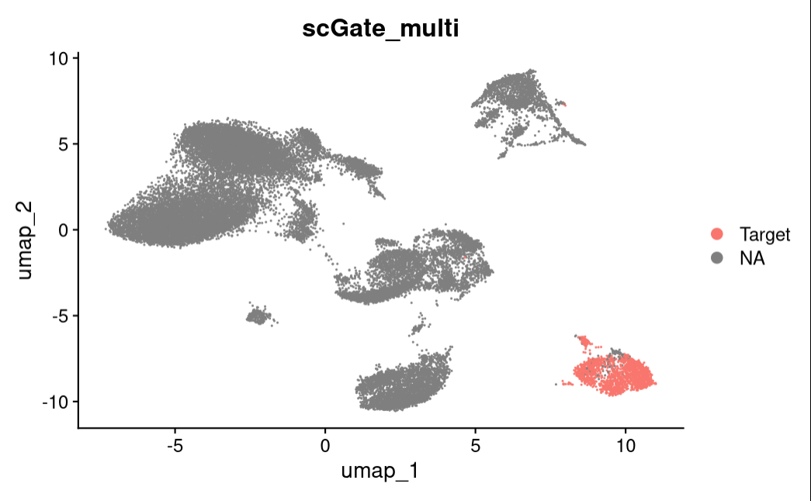
Labeled T Cells in Mair et.al After Gating

Slide 29
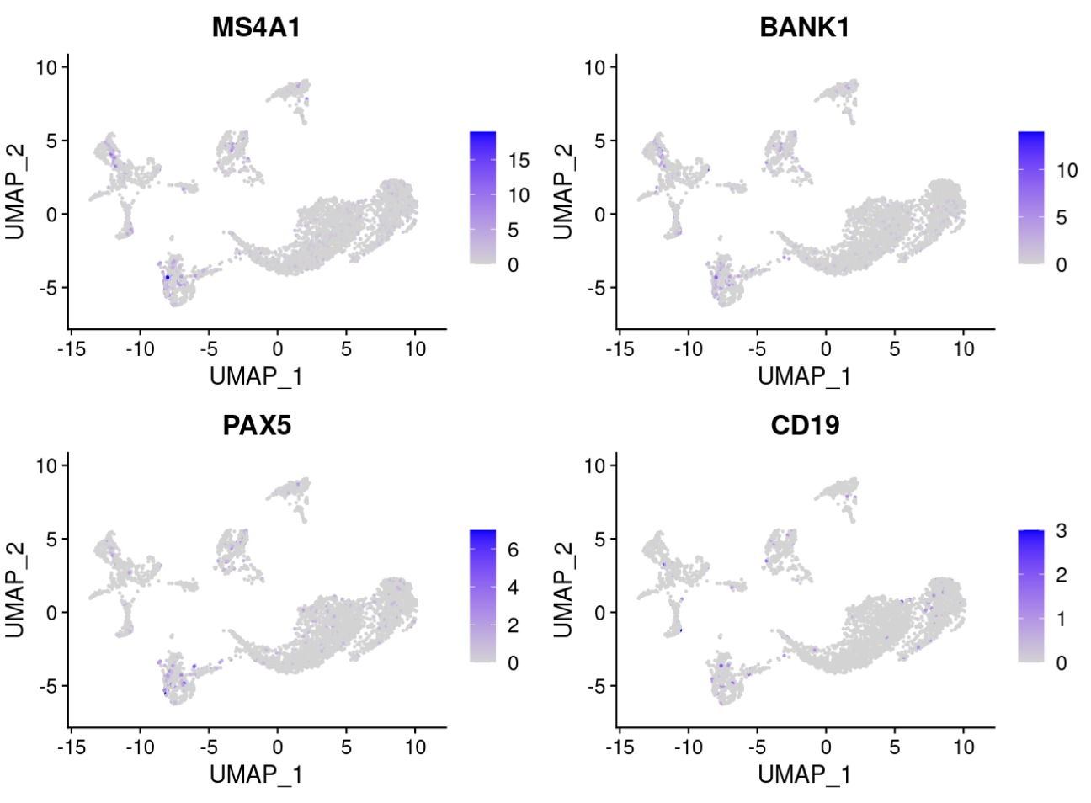
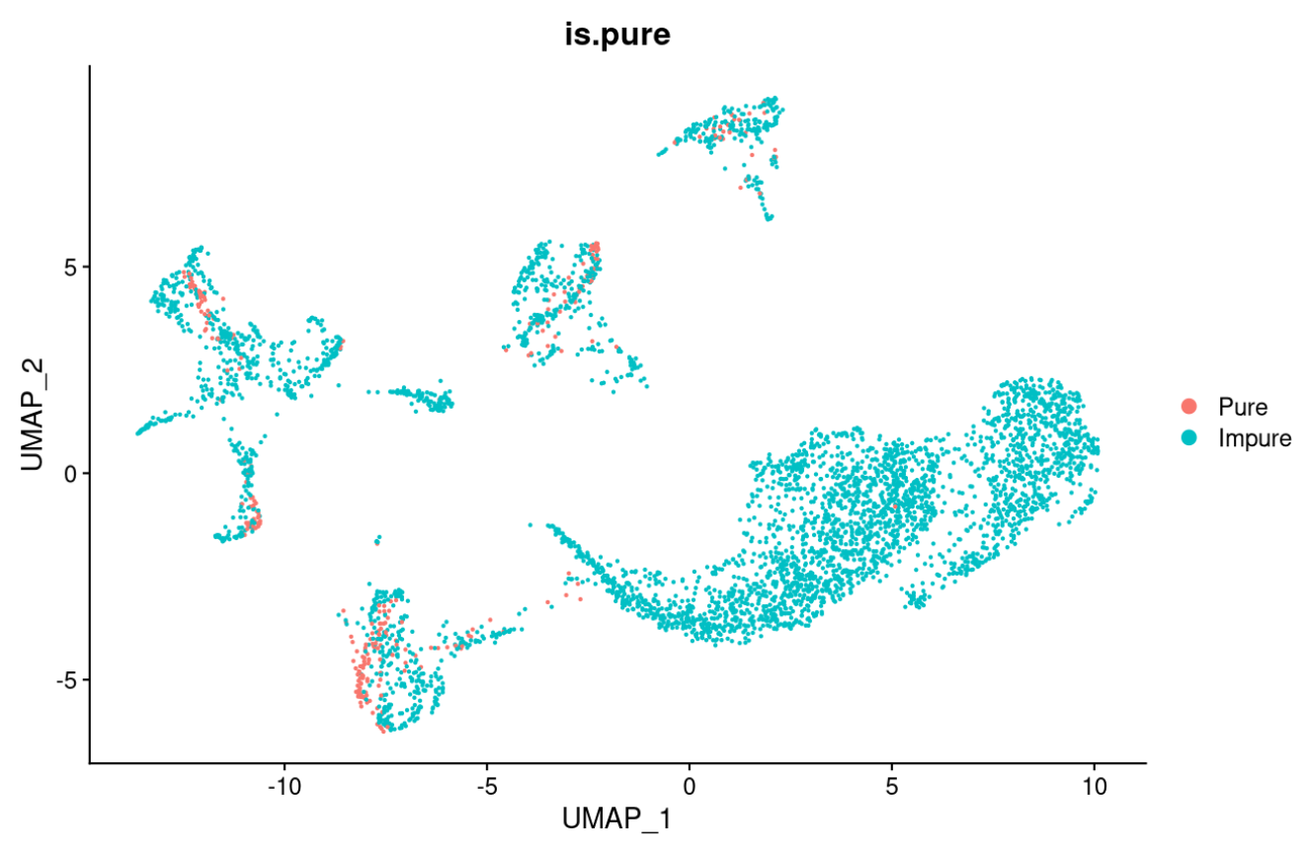

Slide 31
